Slide 1
DIGITAL LOGIC DESIGN
EE(109)
LECTURE-11
DATE: 13TH FEB, 2018

Slide 2
Chapter No:4
Boolean Algebra and logic Simplification

Slide 3
CHAPTER OUTLINE
Boolean Operations and Expressions
Laws and Rules of Boolean Algebra
DeMorgan’s Theorems
Boolean Analysis of Logic Circuits
Logic Simplification Using Boolean Algebra
Standard Forms of Boolean Expressions
Boolean Expressions and Truth Tables
The Karnaugh Map
Karnaugh Map SOP Minimization
Karnaugh Map POS Minimization

Slide 4
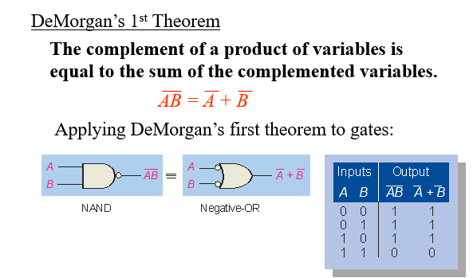
DEMORGAN ’S THEOREM
De Margan ’s theorem are extremely useful in simplifying expressions in which a product or sum of variables is inverted.

Slide 5
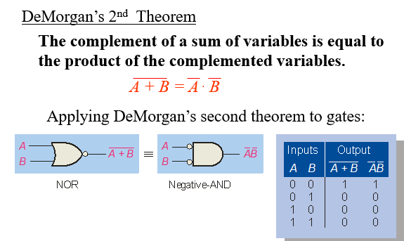

Slide 6
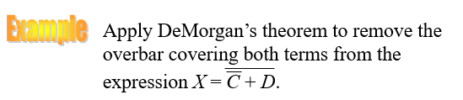
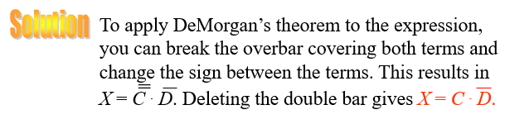

Slide 7




DEMORGAN ’S THEOREM
Apply DeMargan theorem:

Slide 8



EXAMPLE

Slide 9

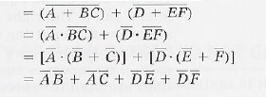


EXAMPLE

Slide 10

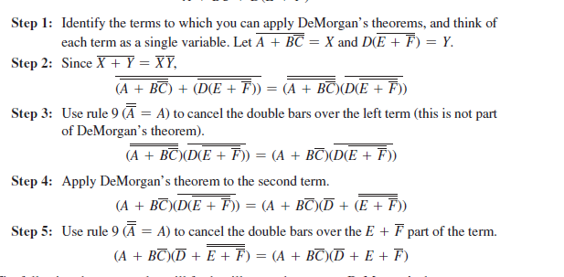

Slide 11

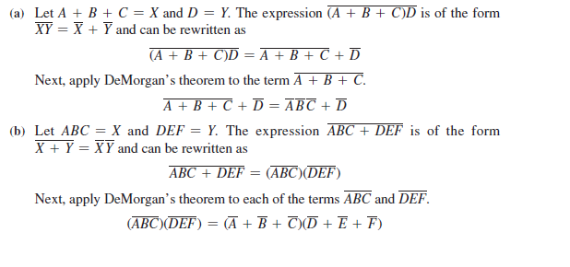

Slide 12
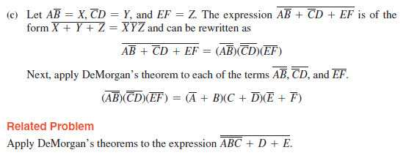

Slide 13
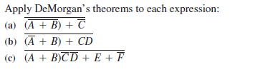
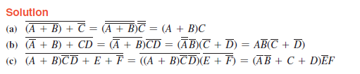

Slide 14

